Slide 1
CSC 60 Section 3 Instructor: Ruthann Biel

Slide 2
Introduction
Getting Started

Slide 3
Computer Accounts
There are no more ECS accounts. We will all use SacLink accounts.

Slide 4
Process needed to deal with a program

Slide 5
Detailed directions depending on your computer
Use one on the Plan documents to help you log in.
Plan A Putty and File Transfer. Windows.docx
Plan B Mac Alternatives.docx
Plan C Mobaxterm. Windows.docx
The Plans also contain information on moving your assignment files from the Linux computer to your own computer so you can upload those files to Canvas for a grade.

Slide 6
Vocabulary
ECS - Engineering and Computer Science
Putty - software that lets us connect from our own computer
to the Linux computer
The names of the Linux computers that we will use.
Short Name | Long Name
ecs-coding1.csus.edu | ecs-pa-coding1.ecs.csus.edu
ecs-coding2.csus.edu | ecs-pa-coding2.ecs.csus.edu
ecs-coding3.csus.edu | ecs-pa-coding3.ecs.csus.edu

Slide 7
General Process needed to deal with a program: 1 of 3
Bring up GlobalProtect if needed
Log onto the Linux computer
Consult the Plan A,B,C that you have chosen
Windows machines: Use PuTTY or MobaXterm
MAC machines: Open up a terminal/console window (ssh)
Open an editor. (C programmers use vim.)
Write code, compile, fix, save, etc.

Slide 8
Process needed to deal with a program: 2 of 3
At this point, your work is stuck on the Linux machine, but you need access to the files so you can upload them via your browser to Canvas.
There are multiple choices with lots of help in the Plans:
Save your file to your campus OneDrive. Open your Browser, look for the file on the OneDrive and upload it. (Your computer needs to know about your campus OneDrive.)
We can use File Transfer software to transfer the files to a place where you can open your browser and upload them to Canvas.
MAC Users can also move their file via SCP.

Slide 9
Many Choices - transfer files from Linux to browser: 3 of 3
Use file transfer software to move the code from Linux machine to your own computer. (WinSCP, FileZilla, CyberDuck)
Mac: Use scp to transfer the file. The directions are to be found on Canvas dashboard for this class in a published course named “ECS Resource Center – Students”. There are directions on the use of scp on Canvas, under Reference, file named SCP Guide for Macs.docx
Mac: If you can’t reference the ECS window yet, go to our class on Canvas, under Reference, file named Orig SCP Guide for Macs.docx
You can email the files to yourself and download them from there. On the Linux computers, the email handler is named Alpine.

Slide 10
Section 1. Global Protect for your personal computer

Slide 11
Installing Global Protect
One-Time Action:
Install VPN software named GlobalProtect. You will need to connect to
GlobalProtect before accessing CSUS servers (1): if you are connecting from a non-campus computer, and (2): not on the campus network. There are 2 choices below for directions
Here is the link for the instructions to connect to GlobalProtect: https://www.csus.edu/college/engineering-computer-science/computing-services/_internal/_documents/globalprotect-vpn.pdf.
Available to students who were here last semester:
The directions are also to be found on Canvas dashboard for this class. There is a published course named “ECS Resource Center – Students”. Scroll down to the second module “GlobalProtect”. Make the appropriate choice for the machine you will use.

Slide 12
Section 2. Logging in to Linux via PuTTy

Slide 13
Logging onto a Linux machine
Sit at a computer and log in.
As you enter your password, nothing will show on the screen.
Do a remote login using SSH
Some of us use PuTTY software to accomplish this.
The ECS computers all have PuTTY
To get PuTTY at home (free) , download it from: https://www.putty.org/

Slide 14
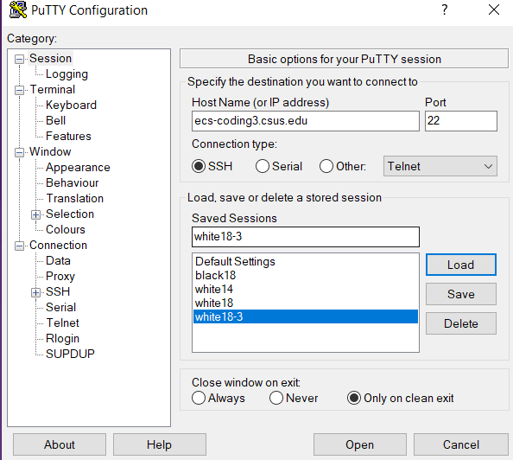
Putty Log-In Screen
Address of Linux computer
ecs-coding3.csus.edu
Choose the option - SSH
I saved the session, named it “White18-3”
18 for the font, 3 for Coding computer
Once the session is saved
We can just double-click on the session name,
and the log-in widow will appear
Contains options to change font and font size

Slide 15
MAC Users - Logging in
Open up a terminal/console window and type the following:
ssh yourCSUname@ecs-coding1. csus.edu
Example: ssh bielr@ecs-coding1.csus.edu
Press Enter.
When prompted, type “yes” to accept the server’s key.
Then enter your password.

Slide 16
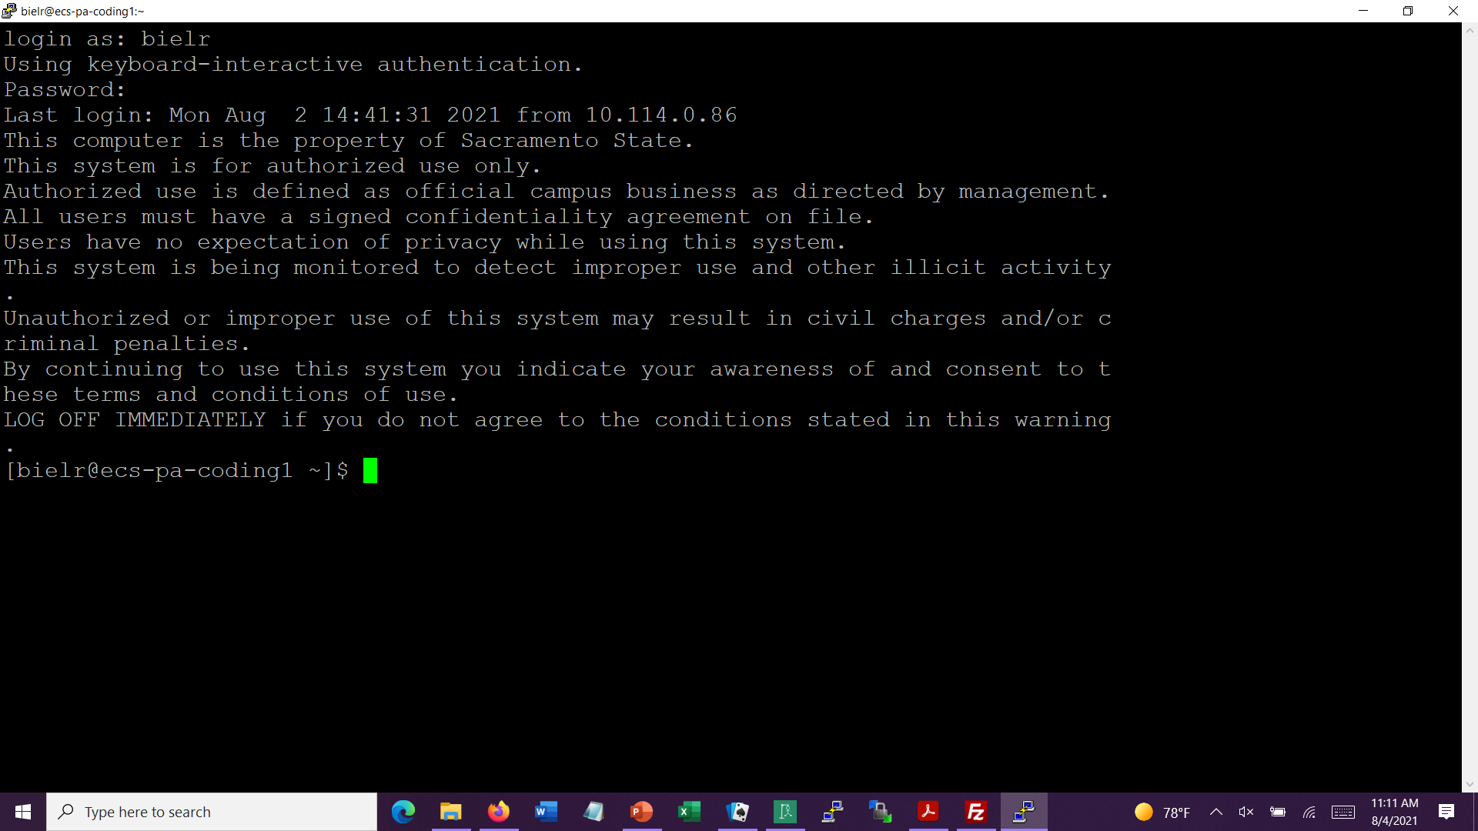
Login Screen (black with white)

Slide 17
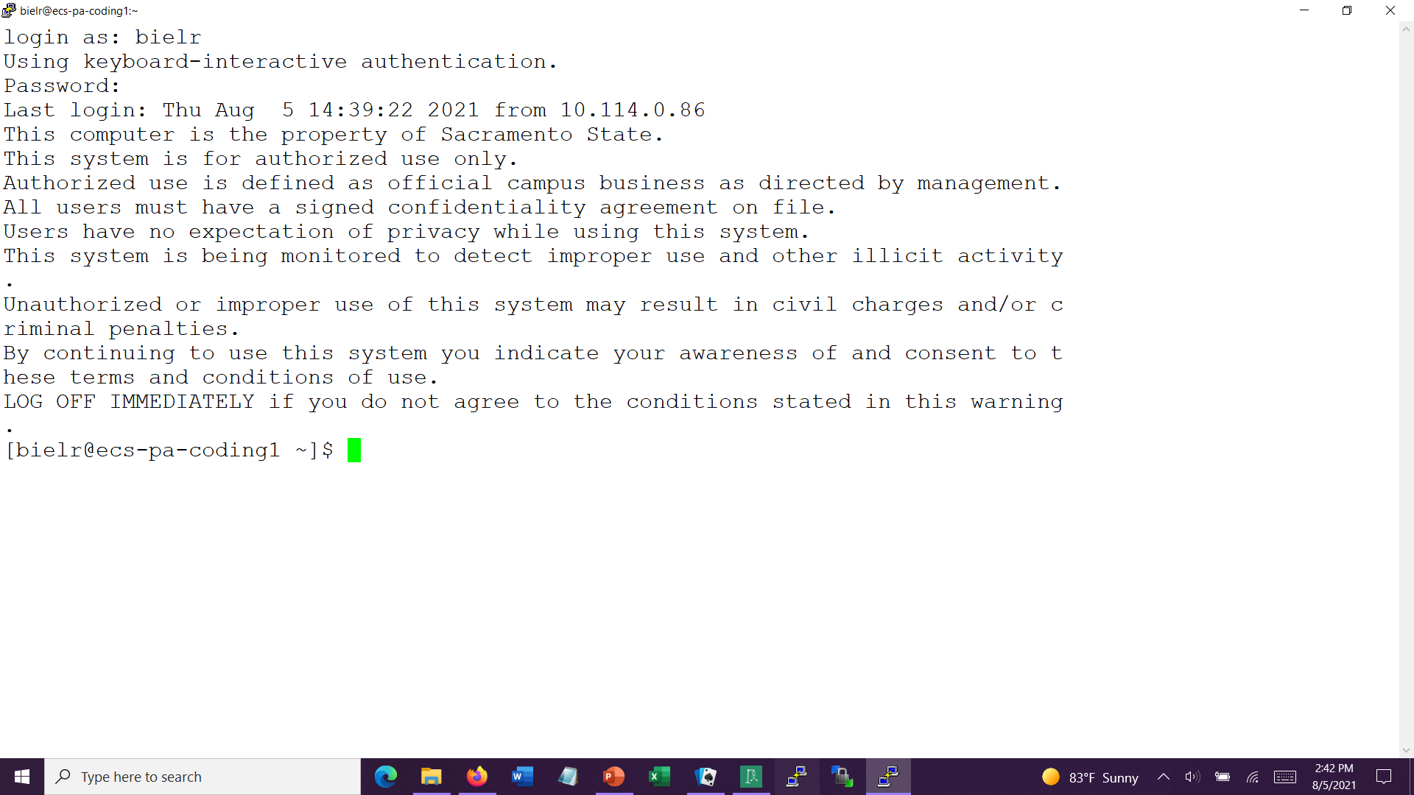
Login Screen (white with black)

Slide 18
Section 5. Software for moving files between laptop/home and Linux

Slide 19
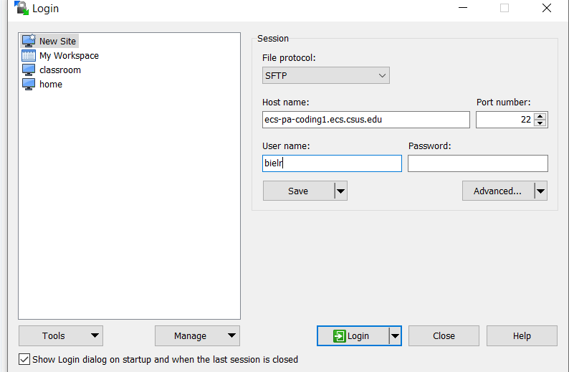
WinSCP Log-in Screen with settings

Slide 20
Transfer Software for home:
Why – We will be working on a Linux machine to create our code and run it. When you are finished with the assignment, the files are on that Linux machine.
But how to do this at home or on a laptop? One choice is to use free file transfer software to move the file from Linux to your personal computer.

Slide 21
Optional Transfer software for home - Windows:
WinSCP – free software that allows one to move files from one site to another, from athena to home, and the reverse.
At the site, free: http://winscp.net/
Next slide shows startup menu with entries for instructor
The same information will be needed whether you use WinSCP or another product.

Slide 22
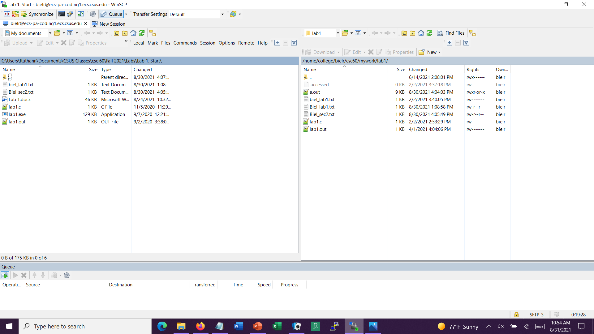
WinSCP Sample Screen: left shows home computer, right – Linux computer
Click on a file in one half and drag to the other half.

Slide 23
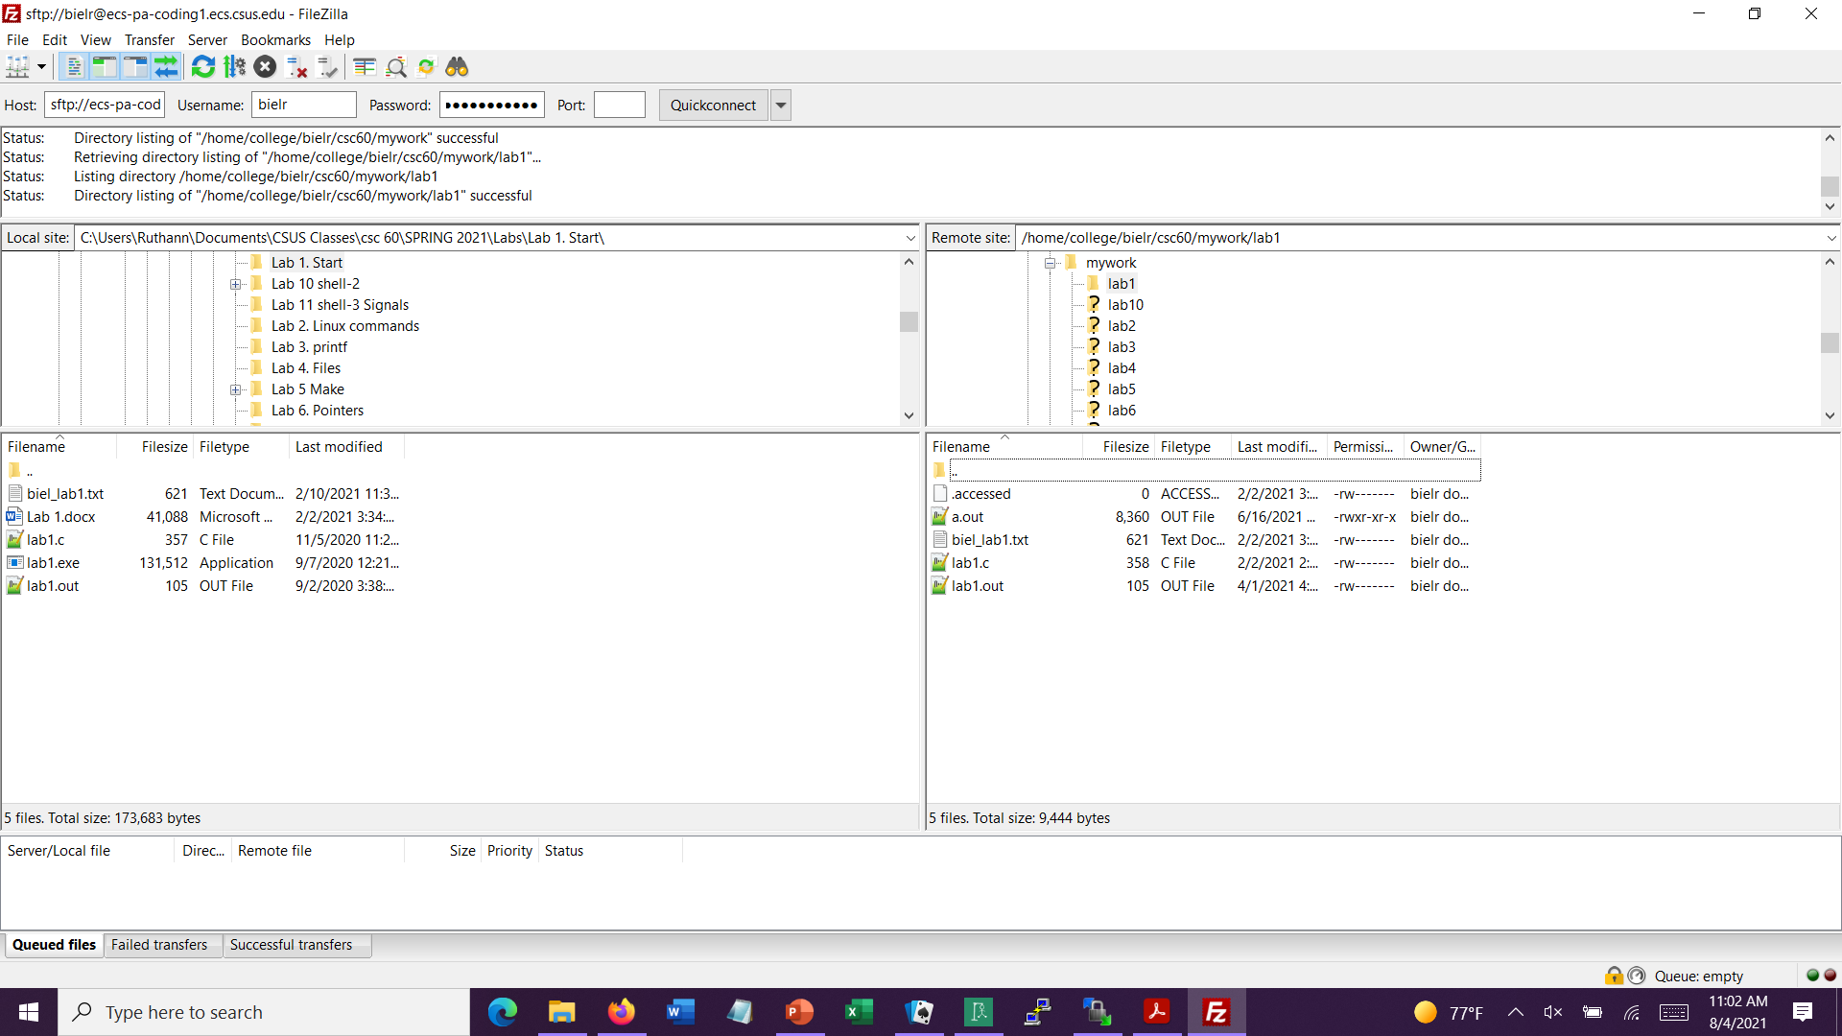
Filezilla Log-in Screen with settings

Slide 24
Optional software for home (MAC & Windows):
Free software that allows one to move files from one site to another, from Linux to home, and the reverse.
Filezilla – https://filezilla-project.org/
Cyberduck - https://cyberduck.io/?l=en
Both software packages work on Windows or Mac.
A search on “cyberduck vs filezilla” will bring up a couple of comparison articles.

Slide 25
Another Alternative…
An alternative all-in-one software that combines the jobs of Putty and of WinSCP (file transfer software).
The link to their home page: https://mobaxterm.mobatek.net/
The link to download it. There is a free version (and a commercial version that one must pay for): https://mobaxterm.mobatek.net/download.html
I am not a Moxbaxterm user so I can not answer every possible question about its use.

Slide 26
Files to Help…on Canvas under Reference
Cheat Sheet for CSC60.pdf
Linux, vim, Linux login, program creation, transfer files
SCP Guide for Macs.pdf
Change font size while logged onto Linux.pdf
4. Vim Commands Link.pdf
VIM Quick Reference Guide.pdf
Plans A, B, and C

Slide 27
Using the C compiler on your Mac

Slide 28
Using the compiler on your Mac
I personally have no experience with using a Mac.
The ECS IT department found the following links that ought to help you:
https://www.cs.auckland.ac.nz/~paul/C/Mac/
https://mkyong.com/mac/how-to-install-gcc-compiler-on-mac-os-x/

Slide 29
Start Understanding Linux

Slide 30
Shells:
A shell is an interface between you and the kernel of UNIX/Linux.
Kernel. The center, the core.
Shell. A way to communicate with the Kernel.
The default on our system is bash.
Another shell is csh, read aloud as ‘C-shell’.

Slide 31
By doing “cat /etc/shells”, I found that Coding1 has:
/bin/sh (Bourne Shell)
/bin/bash (superset, Born Again Shell. LOL)
/bin/tcsh
/bin/csh (spoken as C-shell)
/usr/bin/sh
/usr/bin/bash
/usr/bin/tmux
It is possible to change the default shell,
using the command “chsh”.
Notes:
I have bash

Slide 32
Shell Verification
To see what Shell you are in, type:
$ echo $SHELL

Slide 33
Getting Linux help:
“Look at the “man” page.” You will hear this expression.
This means looking at the on-line manual which is extensive.
$ man command
Examples: /* will show you… */
$ man ls /* all the options for listing */
$ man gcc /* options for the compiler */
Maneuvering through a man page:
Hit space bar to advance thru page.
Hit Enter to advance the screen one line.
Hit “q” to quit.

Slide 34
Various Commands in Linux

Slide 35
Command: ls
Purpose: List files in directory.
Format: ls [options] [file-list]
Some Options:
-a List all files, including hidden ones.
-d List directory names only, not ordinary files.
-g Show group information with listing.
-l Show long listing with extended information.
-r List in reverse order.
-s List in order of increasing size.
-t List in order of time, most recent first.
Examples: ls ls -ra
ls –l ls -ls

Slide 36
Copying and Renaming Files:
Command: cp
Purpose: Copy a file.
Format: cp source-file target-file
Example: cp my.file file2
Result: There are now two identical files with different names.

Slide 37
Moving or renaming files:
Command: mv
Purpose: Move or rename a file.
Format: mv source-file target-file
Example: mv my.file file2
Result: One file with the target name exists.

Slide 38
Removing files:
Command: rm
Purpose: Remove a file.
Format: rm [option] file(s)
Option: -i Ask before deleting.
Often the default.
Example: rm file2, rm –i file2
Result: The file is no longer listed or available.

Slide 39
The cat command:
Command: cat
Purpose: Display or create files.
Format: cat [source-file] [symbol] [target-file]
Examples: 1. cat this.month
2. cat lab2.c
Result: File displayed on the screen, lines echoed on screen

Slide 40
The pwd command:
Command: pwd
Purpose: print name of current/working directory.
Format: pwd
Example & Result:
[bielr@ecs-pa-coding1 ~]$ pwd
/home/college/bielr
[bielr@ecs-pa-coding1 ~]$

Slide 41
Starting Directory Structure on Linux
/ (root)
home home many-other-directories
college student
bielr smithjohn
csc60 csc 25 classfiles_csc60 csc60
mywork ClassExamples myworkS19 lab2
lab1 lab2 lab3

Slide 42
The cd command:
Command: cd
Purpose: Change directory.
Examples & Results:
1. cd Takes you to your home directory
cd .. Takes you up to the parent directory, up one level
cd lab1 Takes you down to a lower directory, down one level
cd mywork/lab1 Takes you down to a lower directory, down two levels

Slide 43
The mkdir command:
Command: mkdir
Purpose: Make directories.
Examples & Results:
1. mkdir csc60 Makes a sub-directory named csc60
mkdir lab2 Makes a sub-directory named lab1
Directories can also be moved or renamed (mv), and copied (cp –r)

Slide 44
The rmdir command:
Command: rmdir
Purpose: remove empty directories.
Examples & Results:
1. rmdir csc60 Removes the sub-directory named csc60
rmdir lab1 Removes a sub-directory named lab1
Note:
To delete an empty directory, you must be in the directory above it or you need to type a full path name.

Slide 45
The clear command:
Command: clear
Purpose: clear the terminal screen
Example:
> clear

Slide 46
Other Assorted Commands
less, more – paging utilities
Use the “man” pages to find more
od – octal dump. For viewing raw data in octal, hex, control chars, etc.
Use the “man” pages to find more
ln – create hard (inode) or soft (symbolic) links to a file
[On creating a file, UNIX allocates the file an inode
number of 4 bytes, an index value for an array on the
disk. So every file has a unique inode number.]

Slide 47
?? Change The Prompt On Our Linux Machine
Change the prompt to show the folder/directory that you are in.
You need to type a SPACE after “set” and after the “/”.
Type in the command: set prompt=’[%n%/ %~]!$’
The %n will show your user-name.
The %/ will show your current folder.
The %~ will give you the command number. (I usually leave this off.)
set prompt=’[%n%/ ]!>’

Slide 48
Introduction
1-UNIX Getting Started
The End

